Slide 1

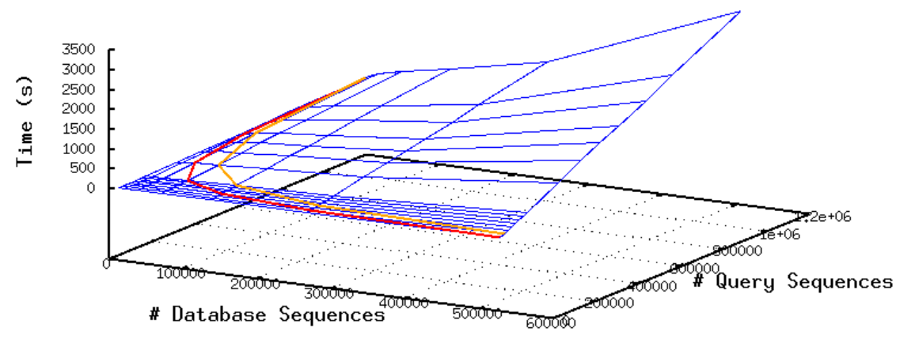
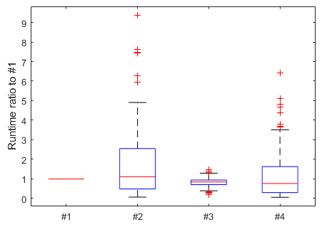
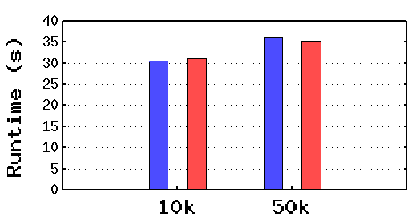
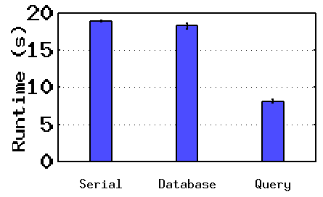
Optimal Data Parallelization of the BLAST Bioinformatics Application on HPC Clusters
Trinity Cheng^{1,3}, Pei-Ju Chin, PhD², Mike Mikailov, PhD¹
¹CDRH/OSEL/Division of Imaging, Diagnostics, and Software Reliability
²CBER/OVRR/DVP/Laboratory of Retroviruses
³River Hill High School, Howard County, Maryland
Abstract
The goal of this project is to find the optimal data segmentation strategy for the BLAST bioinformatics application running on a high-performance computing cluster with hundreds of computing nodes. Presented in this poster are the initial results from the first four weeks focusing on the important factors that may affect the BLAST performance. We investigated the impact of database size, query size, number of nodes, multi-threading options, hardware capability, and sequence redundancy. The first four factors were found critical and will be studied in depth in the second stage of research.
Introduction
The Basic Local Alignment Search Tool (BLAST) is a software package developed by NIH/NCBI for comparing biological sequences, such as DNA or amino acid sequences. Since its development in 1990, BLAST has become one of the most widely used bioinformatics applications, with the original publication cited more than 94 thousand times.¹ BLAST finds matching sequences between two user-provided files: the database file and the query, which both frequently have millions of lines of text, making BLAST computationally challenging and suitable for high-performance computing (HPC). Mikailov et al proposed the dual segmentation method, which divides the database file into m fragments and the query file into n fragments for m*n processing nodes on an HPC cluster.² Although the experiment results demonstrated promising speedup, the optimal division of (m,n) is still unknown. In this study, we characterized the BLAST performance for a processing node by controlling five factors: database/query file size (Exp 1), number of processing nodes (Exp 2), multi-threading option (Exp 3), hardware capability (Exp 4), and sequence redundancy (Exp 5).
Figure 1. The blue mesh of 90 datapoints represents runtime in Exp 1 vs. #database (x-axis) and #query (y-axis). The red and orange contours are overlaid to represent the runtimes when using 4,096 and 2,048 nodes, respectively, to parallelize the BLAST job in Exp 2.
Figure 3. The runtimes of node types #2, #3, and #4 relative to node type #1. The 90 database/query combinations from Exp 1 were used to test.
Exp 5: Runtime vs. Sequence Redundancy
Exp 3: Runtime vs. Multi-Threading
Goal: Investigate impact of repeated sequences (redundancy) on runtime
Method: Create “phantom” databases with controllable redundancy
Results: See Figure 4
Finding: Redundancy seems to have little effect on runtime
Goal: Investigate impact of multi-threading (MT) supported by the latest BLAST released in June 2021
Method: Compare splitting-by-database vs. splitting-by-query
Results: See Figure 2
Finding: Splitting-by-query reduced runtime to 44%
Figure 4. From left to right, BLAST runtime with 10k unique database, 10k redundant database, 50k unique database, 50k redundant database. The 10k redundant database had a runtime 102% of the 10k unique, and the 50k redundant database had a runtime 98% of the unique.
Figure 2. With 4 cores, MT by splitting database (center) reduced runtime to 96.7% compared to serial (left), whereas MT by splitting query reduced the runtime to 42.7%. #database d = 8,179 and #query q = 89,258 were used.
Exp 1: Runtime vs. #Database and #Query
Goal: Investigate impact of number of database sequences (#database) and number of query sequences (#query) on runtime
Method: Run different combinations of #database and #query simultaneously on HPC clusters to measure runtime quickly
Results: See blue mesh in Figure 1
Finding: Tilted mesh => smaller #query runs faster than smaller #database
Conclusion
Exp 4: Runtime vs. Hardware
To find the optimal data partitioning for BLAST, five factors were investigated in the first stage of this project. The approach of simultaneous evaluation with multiple nodes was used to quickly construct a 3D mesh for analyzing the solution space. Phantom databases were created to study the sequence redundancy. Experiment data show that the database size, query size, and multi-threading option are significant for the runtime, while reducing query size is more effective than reducing the database size. These findings will guide the second stage of this project to develop a benchmark suite for estimating BLAST performance for HPC clusters.
Goal: Investigate impact of hardware components
Method: Repeat Exp 1 on 4 different node types in Table 1
Results: Runtime relative to node type #1 shown in Figure 3
Findings: Node type #3 is faster and more uniform; hard to predict performance by hardware specifications
Exp 2: Runtime vs. #Nodes
Goal: Investigate impact of number of nodes (#nodes) on runtime
Method: Based on the blue mesh in Figure 1, estimate the runtime of running a BLAST job with m*n nodes, where the database and query are divided into m and n fragments, respectively, for each node
#Database = 523,449 sequences
#Query = 73,102,023 sequences
Results: See red contour (4,096 nodes) and orange contour (2,048 nodes) in Figure 1
Findings: For either contour, the optimal solution is near the minimum #query; contour with fewer #node moves uphill due to the distribution of the same workload among fewer processors
References
Table 1. Comparison of hardware specs of the four types of nodes tested.
Altschul SF, Gish W, Miller W, Myers EW, Lipman DJ. Basic local alignment search tool. J Mol Biol 1990;215(3):403–410. Epub 1990/10/05. https://doi.org/10.1016/s0022-2836(05)80360-2. PubMed PMID: 2231712.
Mikailov, M., Luo, F. J., Barkley, S., Valleru, L., Whitney, S., Liu, Z., Thakkar, S., Tong, W., & Petrick, N. (2017). Scaling bioinformatics applications on HPC. BMC bioinformatics, 18(Suppl 14), 501. https://doi.org/10.1186/s12859-017-1902-7
Node Type | CPU Model (Age) | #CPU per Node | #Core per CPU | Main Memory (GB) | Network Speed (Gb/s) | Storage Server (TB)
#1 | X5550 (2009) | 2 | 4 | 24 | 40 (Infiniband) 56 (Infiniband) | 350 (GPFS)
#2 | E7-4870 (2011) | 4 | 10 | 256 | 10 (Ethernet) 56 (Infiniband)
#3 | E5-2650 v4 (2016) | 2 | 12 | 512 | 100 (Intel OPA) 10 (Ethernet) 56 (Infiniband)
#4 | E5-4627 v4 (2016) | 4 | 10 | 2000
Acknowledgements
This study was supported by ORISE. The mention of commercial products herein is not to be construed as either an actual or implied endorsement of such products by the Department of Health and Human Services. The author thanks Dr. Kenny Cha, Dr. Arifa Khan, and the CDRH HPC team for their guidance and advice.
www.fda.gov

